Slide 1

CSE-221 Algorithms
Introduction to Algorithms

Slide 2
Algorithm Definition
A finite set of statements that guarantees an optimal solution in finite interval of time
Algorithmic thinking and problem solving skill are vital in making efficient solutions.
The English word "ALGORITHM" derives from the Latin word AL- AL-KHWARIZMI’S name. He developed the concept of an algorithm in Mathematics, and thus sometimes being called the “Grandfather of Computer Science".

Slide 3
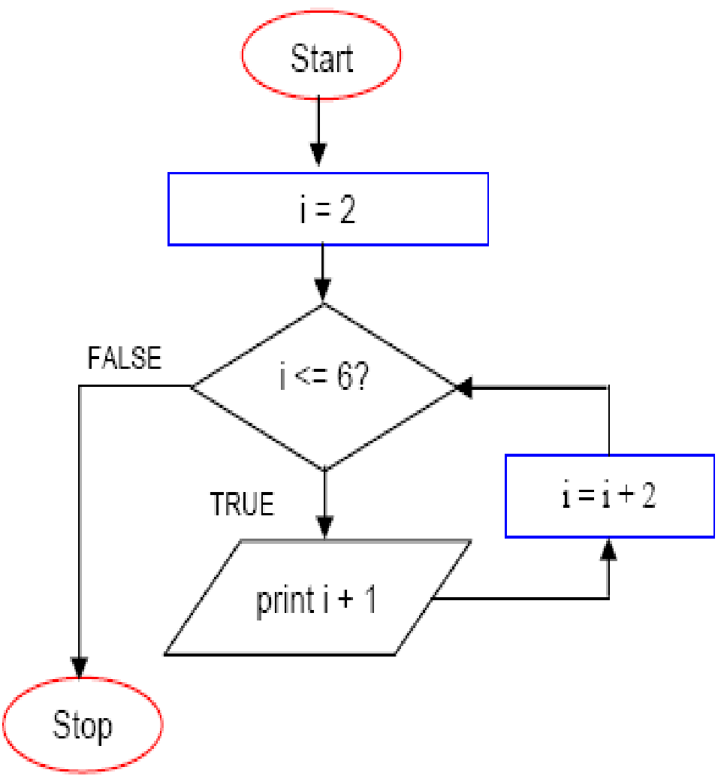
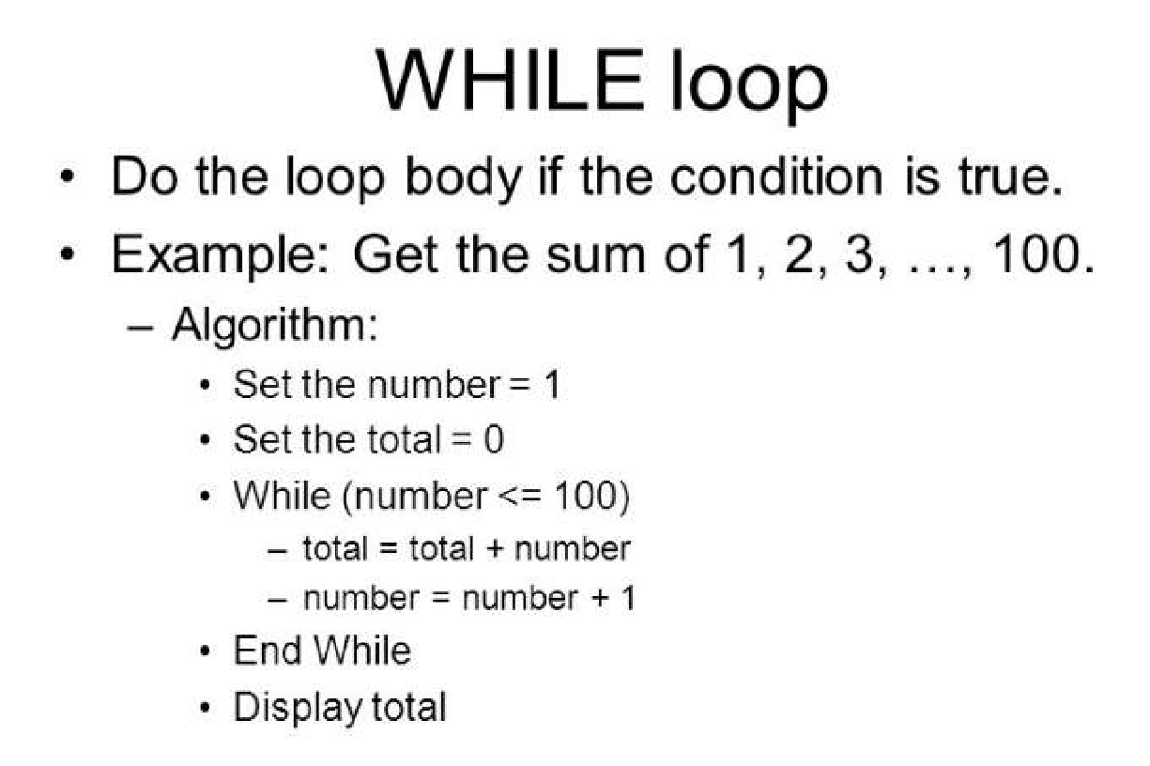
Glance of Algorithm
An algorithm is a finite set of instructions or logic, written in order, to accomplish a certain predefined task.
Algorithm is not the complete code or program
Can be expressed either as an informal high level description as pseudocode or using a flowchart.

Slide 4
Algorithm Specifications
Input - Every Algorithm must take zero or more number of input values from external.
Output - Every Algorithm must produce an output as result.
Definiteness - Every statement/instruction in an algorithm must be clear and unambiguous (only one interpretation)
Finiteness - For all different cases, the algorithm must produce result within a finite number of steps.
Effectiveness - Every Instruction must be basic enough to be carried out and it also must be feasible.

Slide 5
Good Algorithms?
Run in less time
Consume less memory
But computational resources (time complexity) usually important

Slide 6
Analyzing Algorithms
Predict the amount of resources required:
memory: how much space is needed?
computational time: how fast the algorithm runs?
FACT: running time grows with the size of the input
Input size (number of elements in the input)
Size of an array, polynomial degree, # of elements in a matrix, # of bits in the binary representation of the input, vertices and edges in a graph
Def: Running time = the number of primitive operations (steps) executed before termination
Arithmetic operations (+, -, *), data movement, control, decision making (if, while), comparison

Slide 7
Primitive Operation
A basic or primitive operation is an operation that takes constant time (i.e. independent of the size of the input).
Some examples:
Assigning a value to a variable
Performing an arithmetic operation
Comparing two numbers
Accessing a single element in a Python list by index
Calling a function/method
Returning from a function/method

Slide 8
Algorithm Analysis: Example
Alg.: MIN (a[1], …, a[n])
m ← a[1];
for i ← 2 to n
if a[i] < m
then m ← a[i];
Running time:
the number of primitive operations (steps) executed before termination
T(n) =1 [first step] + (n) [for loop] + (n-1) [if condition] + (n-1) [the assignment in then] = 3n - 1
Order (rate) of growth:
The leading term of the formula
Expresses the asymptotic behavior of the algorithm

Slide 9
Typical Running Time Functions
1 (constant running time):
Instructions are executed once or a few times
logN (logarithmic)
A big problem is solved by cutting the original problem in smaller sizes, by a constant fraction at each step
N (linear)
A small amount of processing is done on each input element
N logN
A problem is solved by dividing it into smaller problems, solving them independently and combining the solution

Slide 10
Typical Running Time Functions
N² (quadratic)
Typical for algorithms that process all pairs of data items (double nested loops)
N³ (cubic)
Processing of triples of data (triple nested loops)
N^{K} (polynomial)
2^{N} (exponential)
Few exponential algorithms are appropriate for practical use

Slide 11
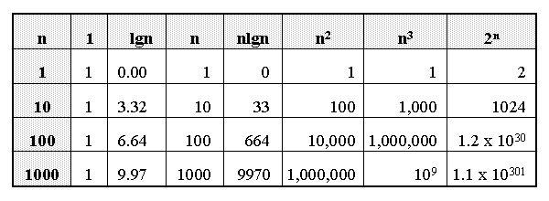
Growth of Functions

Slide 12
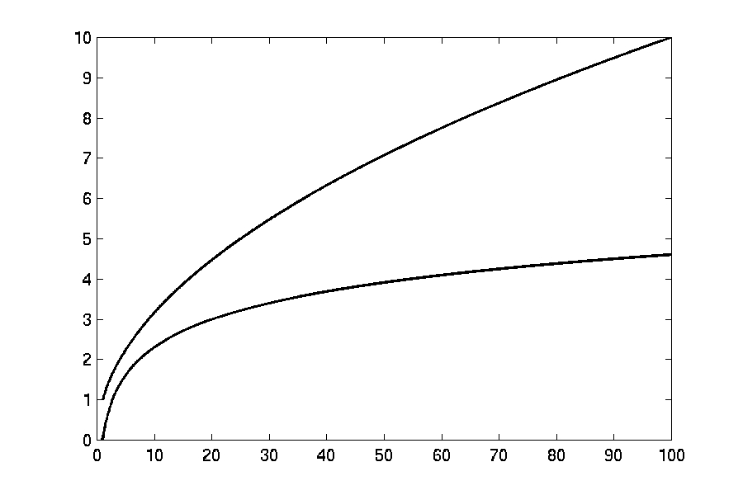

Complexity Graphs
log(n)

Slide 13
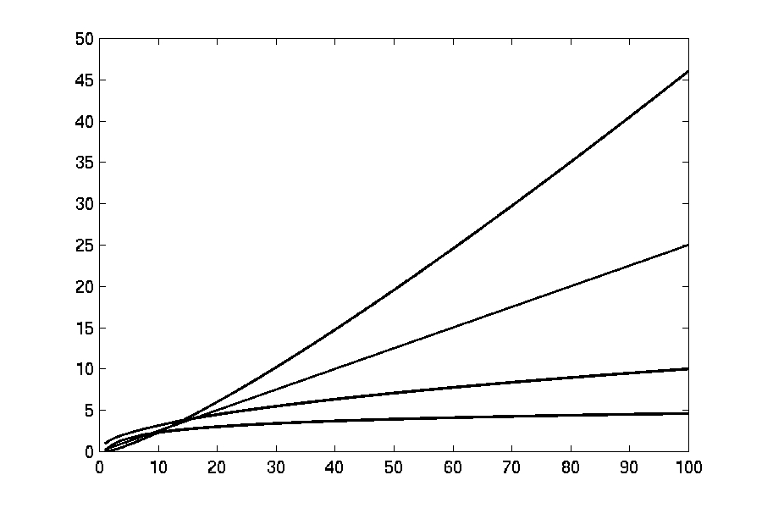

Complexity Graphs
n log(n)
n
log(n)

Slide 14
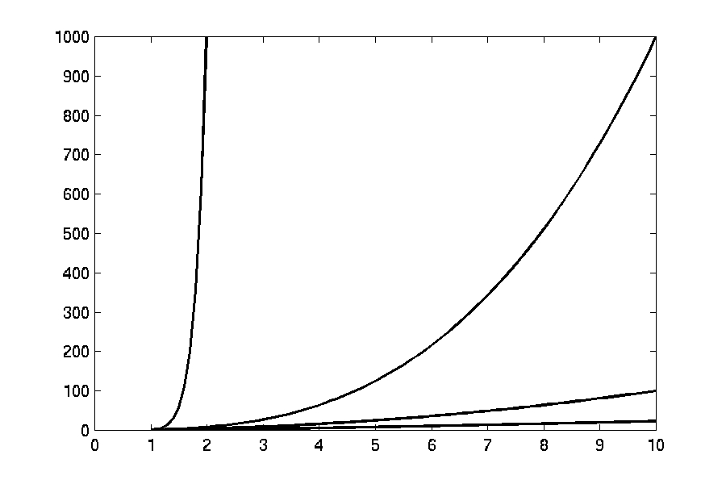
Complexity Graphs
n¹⁰
n³
n²
n log(n)

Slide 15
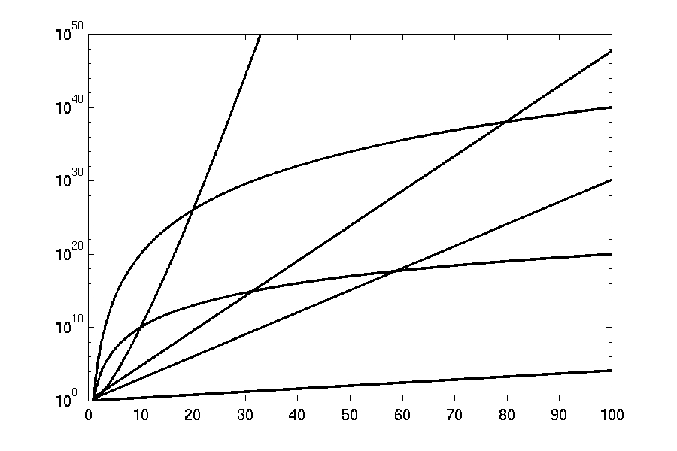
Complexity Graphs (log scale)
3^{n}
n^{n}
n²⁰
2^{n}
n¹⁰
1.1^{n}

Slide 16
Algorithm Complexity
Worst Case Complexity:
the function defined by the maximum number of steps taken on any instance of size n
Best Case Complexity:
the function defined by the minimum number of steps taken on any instance of size n
Average Case Complexity:
the function defined by the average number of steps taken on any instance of size n

Slide 17
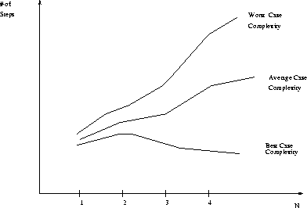
Best, Worst, and Average Case Complexity
Number of steps
Worst Case Complexity
Average Case Complexity
Best Case Complexity
N
(input size)

Slide 18
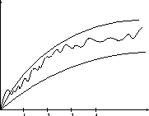
Doing the Analysis
It’s hard to estimate the running time exactly
Best case depends on the input
Average case is difficult to compute
So we usually focus on worst case analysis
Easier to compute
Usually close to the actual running time
Strategy: find a function (an equation) that, for large n, is an upper bound to the actual function (actual number of steps, memory usage, etc.)
Upper bound
Actual function
Lower bound

Slide 19
Asymptotic Growth
When trying to decide whether an algorithm is efficient we are only interested in the value of its time complexity for large values of n, because for small values of n the running time of an algorithm is very small. (For example, in the previous table, for values of n smaller than 100 the running times are much smaller than 1 second. However, for n = 1 million, the running time of the algorithm is 173 days.)

Slide 20
Asymptotic Growth
For large values of n, the value of the time complexity function is mainly determined by the largest term in the function. For example, for the above time complexity t(n) = 15n² + 45n the largest term is 15n² . Notice that for large values of n, the value of 15n² is much bigger than the value of 45n. We say that 15n² asymptotically dominates 45n and so that t(n) has the same asymptotic behaviour as 15n² .

Slide 21
Motivation for Asymptotic Analysis
An exact computation of worst-case running time can be difficult
Function may have many terms:
4n² - 3n log n + 17.5 n - 43 n^{⅔} + 75
An exact computation of worst-case running time is unnecessary
Notes:
Random Access Machine (RAM) model. This model assumes a single processor. In the RAM model, instructions are executed one after the other, with no concurrent operations. This model of computation is an abstraction that allows us to compare algorithms on the basis of performance. The assumptions made in the RAM model to accomplish this are:
Each simple operation takes 1 time step.
Loops and subroutines are not simple operations.
Each memory access takes one time step, and there is no shortage of memory.

Slide 22
Classifying functions by their Asymptotic Growth Rates
asymptotic growth rate, asymptotic order, or order of functions
Comparing and classifying functions that ignores
constant factors and
small inputs.
The Sets big oh O(g), big theta Θ(g), big omega Ω(g)

Slide 23
Classifying functions by their Asymptotic Growth Rates
O(g(n)), Big-Oh of g of n, the Asymptotic Upper Bound
Θ(g(n)), Theta of g of n, the Asymptotic Tight Bound
Ω(g(n)), Omega of g of n, the Asymptotic Lower Bound
Notes:
asymptotically tight bound: Definition: When the asymptotic complexity of an algorithm exactly matches the theoretically proved asymptotic complexity of the corresponding problem. Informally, when an algorithm solves a problem at the theoretical minimum.

Slide 24
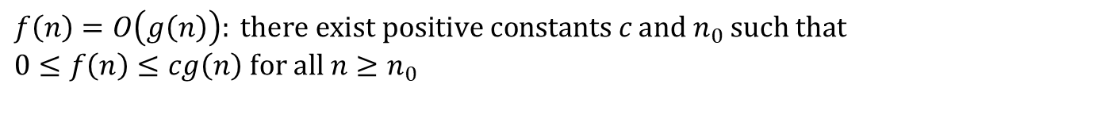
Big-O
What does it mean?
If f(n) = O(n²), then:
f(n) can be larger than n² sometimes, but…
We can choose some constant c and some value n₀ such that for every value of n larger than n₀ : f(n) < cn²
That is, for values larger than n₀, f(n) is never more than a constant multiplier greater than n²
Or, in other words, f(n) does not grow more than a constant factor faster than n².

Slide 25
Visualization of O(g(n))
cg(n)
f(n)
n₀
‹#›

Slide 26
Examples
2n² = O(n³):
n² = O(n²):
1000n²+1000n = O(n²):
n = O(n²):
2n² ≤ cn³ ⇒ 2 ≤ cn ⇒ c = 1 and n₀= 2
n² ≤ cn² ⇒ c ≥ 1 ⇒ c = 1 and n₀= 1
1000n²+1000n ≤ cn² ≤ cn²+ 1000n ⇒ c=1001 and n₀ = 1
n ≤ cn² ⇒ cn ≥ 1 ⇒ c = 1 and n₀= 1

Slide 27
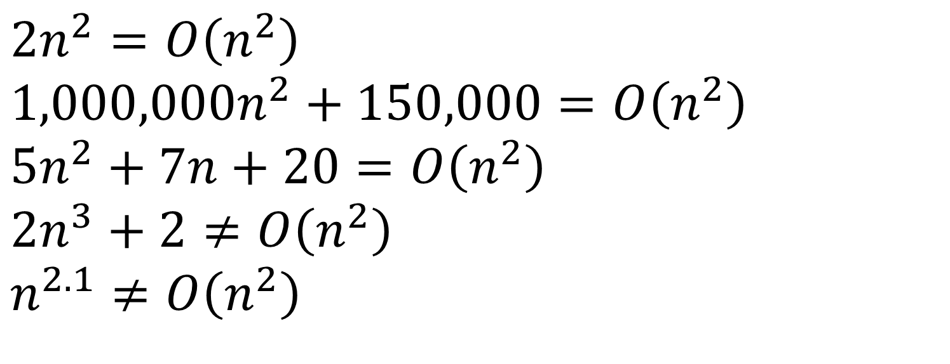
Big-O

Slide 28
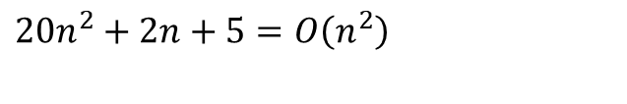
More Big-O
Prove that:
Let c = 21 and n₀ = 4
21n² > 20n² + 2n + 5 for all n > 4
n² > 2n + 5 for all n > 4
TRUE
‹#›

Slide 29
Tight bounds
We generally want the tightest bound we can find.
While it is true that n² + 7n is in O(n³), it is more interesting to say that it is in O(n²)

Slide 30
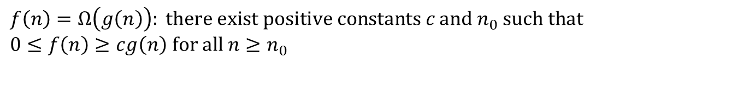
Big Omega – Notation
Ω() – A lower bound
n² = Ω(n)
Let c = 1, n₀ = 2
For all n ≥ 2, n² > 1 × n

Slide 31
Visualization of Ω(g(n))
f(n)
cg(n)
n₀

Slide 32
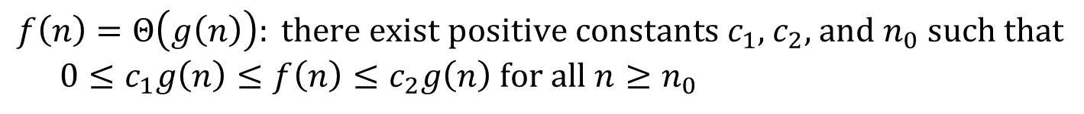
Θ-notation
Big-O is not a tight upper bound. In other words n = O(n²)
Θ provides a tight bound
In other words,

Slide 33
Visualization of Θ(g(n))
c₂g(n)
f(n)
c₁g(n)
n₀
‹#›

Slide 34
A Few More Examples
n = O(n²) ≠ Θ(n²)
200n² = O(n²) = Θ(n²)
n^{2.5} ≠ O(n²) ≠ Θ(n²)

Slide 35
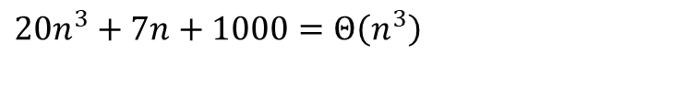
Example 2
Prove that:
Let c = 21 and n₀ = 10
21n³ > 20n³ + 7n + 1000 for all n > 10
n³ > 7n + 5 for all n > 10
TRUE, but we also need…
Let c = 20 and n₀ = 1
20n³ < 20n³ + 7n + 1000 for all n ≥ 1
TRUE

Slide 36

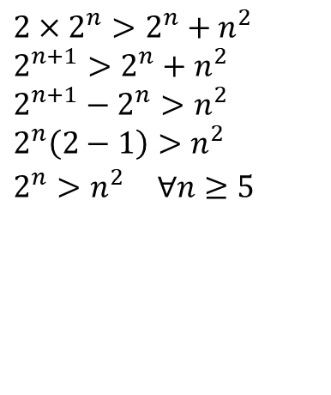
Example 3
Show that
Let c = 2 and n₀ = 5
✔

Slide 37
Asymptotic Notations - Examples
Θ notation
n²/2 – n/2 =Θ(n²)
(6n³ + 1)lgn/(n + 1) = Θ(n²lgn)
n vs. n²
Ω notation
n³ vs. n²
n vs. logn
n vs. n²
n ≠Θ(n²)
O notation
2n² vs. n³
n² vs. n²
n³ vs. nlogn
n³ =Ω(n²)
2n² = O(n³)
n =Ω(logn)
n² = O(n²)
n ≠Ω(n²)
n³ ≠ O(nlgn)

Slide 38
Asymptotic Notations - Examples
For each of the following pairs of functions, either f(n) is O(g(n)), f(n) is Ω(g(n)), or f(n) = Θ(g(n)). Determine which relationship is correct.
f(n) = log n²; g(n) = log n + 5
f(n) = n; g(n) = log n²
f(n) = log log n; g(n) = log n
f(n) = n; g(n) = log² n
f(n) = n log n + n; g(n) = log n
f(n) = 10; g(n) = log 10
f(n) = 2^{n}; g(n) = 10n²
f(n) = 2^{n}; g(n) = 3^{n}
f(n) = Θ(g(n))
f(n) =Ω(g(n))
f(n) =O(g(n))
f(n) =Ω(g(n))
f(n) =Ω(g(n))
f(n) =Θ(g(n))
f(n) =Ω(g(n))
f(n) =O(g(n))

Slide 39
Simplifying Assumptions
1. If f(n) = O(g(n)) and g(n) = O(h(n)), then f(n) = O(h(n))
2. If f(n) = O(kg(n)) for any k > 0, then f(n) = O(g(n))
3. If f₁(n) = O(g₁(n)) and f₂(n) = O(g₂(n)),
then f₁(n) + f₂(n) = O(max (g₁(n), g₂(n)))
4. If f₁(n) = O(g₁(n)) and f₂(n) = O(g₂(n)),
then f₁(n) * f₂(n) = O(g₁(n) * g₂(n))

Slide 40
Some Simplified Rules
O(1) = c , where c is a constant
O(n) = c*n = cn , where c is constant and n is variable
c₁*O(1) = c₁*c = c₂ = O(1) , where c,c₁,c₂ are constants
O(1) + O(1) + O(1) = 3*O(1) = O(1)
5*O(1) = O(1)
n*O(1) = n*c = cn = O(n) , where c is constant and n is variable
O(m) + O(n) ≠ O(m+n)
O(m) * O(n) = c₁mc₂n = (c₁*c₂)(mn) = (c₂)(mn) = O(mn)
O(m)*O(n)*O(p)*O(q) = O(m(n(p(q)))) = O(mnpq)
Example nested for loops
O(an² + bn + c) = O(n²) where a, b , c are constants

Slide 41
Example #1: carry n books from one bookshelf to another one
How many operations?
n pick-ups, n forward moves, n drops and n reverse moves 🡪 4 n operations
4n operations = c. n = O(c. n) = O(n)
Similarly, any program that reads n inputs from the user will have minimum time complexity O(n).

Slide 42
Example #2: Locating Roll-Number record in Attendance Sheet
What is the time complexity of search?
Binary Search algorithm at work
O(log n)
Sequential search?
O(n)

Slide 43
Example #3: Teacher of CSE 221 gives gifts to first 10 students
There are n students in the queue.
Teacher brings one gift at a time.
Time complexity = O(c. 10) = O(1)
Teacher will take exactly same time irrespective of the line length.

Slide 44
Loops with Break
for (j = 0; j < n; ++j) {
// 3 atomics
if (condition) break;
}
Upper bound = O(4n) = O(n)
Lower bound = Ω(4) = Ω(1)
Complexity = O(n)
Ques: Why don’t we have a Θ(…) notation here?

Slide 45
Sequential Search
Given an unsorted vector/list a[ ], find the location of element X.
for (i = 0; i < n; i++) {
if (a[i] == X) return true;
}
return false;
Input size: n = array size()
Complexity = O(n)

Slide 46
If-then-else Statement
if(condition)
i = 0;
else
for ( j = 0; j < n; j++)
a[j] = j;
Complexity = ??
= O(1) + O(N)
= O(N)

Slide 47
Consecutive Statements
Add the complexity of consecutive statements
Complexity = O(3n + 5n) = O(n)
for (j = 0; j < n; ++j) {
// 3 atomics
}
for (j = 0; j < n; ++j) {
// 5 atomics
}

Slide 48
Nested Loop Statements
Analyze such statements inside out
for (j = 0; j < n; ++j) {
// 2 atomics
for (k = 0; k < n; ++k) {
// 3 atomics
}
}
Complexity = O((2 + 3n)n) = O(n²)

Slide 49
Example 1
Code:
a = b;
Complexity:
Notes:
constant

Slide 50
Example 2
Code:
sum = 0;
for (i=1; i <=n; i++)
sum += n;
Complexity:
Notes:
linear

Slide 51
Example 3
Code:
sum = 0;
for (j=1; j<=n; j++)
for (i=1; i<=j; i++)
sum++;
for (k=0; k<n; k++)
A[k] = k;
Complexity:
Notes:
N squared == 1 + 2 + … + N

Slide 52
Example 4
Code:
sum1 = 0;
for (i=1; i<=n; i++)
for (j=1; j<=n; j++)
sum1++;
Complexity:
Notes:
Obviousy n squared

Slide 53
Example 5
Code:
sum2 = 0;
for (i=1; i<=n; i++)
for (j=1; j<=i; j++)
sum2++;
Complexity:

Slide 54
Example 6
Code:
sum1 = 0;
for (k=1; k<=n; k*=2)
for (j=1; j<=n; j++)
sum1++;
Complexity:
Notes:
outer loop O(lg N), inner loop (N) == O (N lg N) by product rule

Slide 55
Example 7
Code:
sum2 = 0;
for (k=1; k<=n; k*=2)
for (j=1; j<=k; j++)
sum2++;
Complexity:
Notes:
outer O (lg N) inner = sum of powers of 2 which is linear since
The sum of powers of 2 dividing into N is 2N so its O (N lg N) by product rule

Slide 56
Recursion
long factorial( int n )
{
if( n <= 1 )
return 1;
else
return n*factorial(n- 1);
}
In terms of big-Oh:
t(1) = 1
t(n) = 1 + t(n-1) = 1 + 1 + t(n-2)
= ... k + t(n-k)
Choose k = n-1
t(n) = n-1 + t(1) = n-1 + 1 = O(n)
Consider the following time complexity:
t(0) = 1
t(n) = 1 + 2t(n-1) = 1 + 2(1 + 2t(n-2)) = 1 + 2 + 4t(n-2)
= 1 + 2 + 4(1 + 2t(n-3)) = 1 + 2 + 4 + 8t(n-3)
= 1 + 2 + ... + 2^{k-1} + 2^{k}t(n-k)
Choose k = n
t(n) - 1 + 2 + ... 2^{n-1} + 2^{n} = 2^{n+1} - 1

Slide 57
Binary Search
Given a sorted vector/list a[ ], find the location of element X
unsigned int binary_search(vector<int> a, int X)
{
unsigned int low = 0, high = a.size()-1;
while (low <= high) {
int mid = (low + high) / 2;
if (a[mid] < X)
low = mid + 1;
else if( a[mid] > X )
high = mid - 1;
else
return mid;
}
return NOT_FOUND;
}
Input size: n = array size()
Complexity = O( k iterations x (1 comparison+1 assignment) per loop)
= O(log(n))

Slide 58
Summary
Time complexity is a measure of algorithm efficiency
Efficient algorithm plays the major role in determining the running time.
Q: Is it possible to determine running time based on algorithm’s time complexity alone?
Minor tweaks in the code can cut down the running time by a factor too.
Other items like CPU speed, memory speed, device I/O speed can help as well.
For certain problems, it is possible to allocate additional space & improve time complexity.

